Slide 1
Requirements
School of Computing and Engineering

Slide 2
Systems Development Methodology
A system development methodology is a formalized approach to implementing the SDLC.
A list of steps and deliverables.
There are many different systems development methodologies, and they vary in terms of the progression that is followed through the phases of the SDLC.
- Waterfall Development
- Parallel Development(variation of the Waterfall Development)
- V-model (variation of the Waterfall Development)
- Rapid Application Development (RAD)
- Agile Development

Slide 3



Input
Process
Output
Planning
Systems Development Process
Planning
Implementation.
Analysis
Design
Systems Analysis and Design is about getting people, processes and technology together to sort out the bit in the middle!

Slide 4
Planning phase
Phase | Step | Technique | Deliverable | Output
Planning: Why build this system? How to structure the project? | Project Initiation: Identify opportunity Analyse feasibility | Project identification Technical feasibility Economic feasibility Organisational feasibility | System Request Feasibility study | System Request with feasibility study. Project Plan
 | 2.Project Management Develop work plan Staff project Control and direct project | Time estimation Task identification Work breakdown structure PERT chart Gantt chart Scope management Project Staffing Project charter CASE repository Standards Documentation Time boxing Risk Management | Project Plan: Work plan Staffing plan Standards list Risk assessment

Slide 5
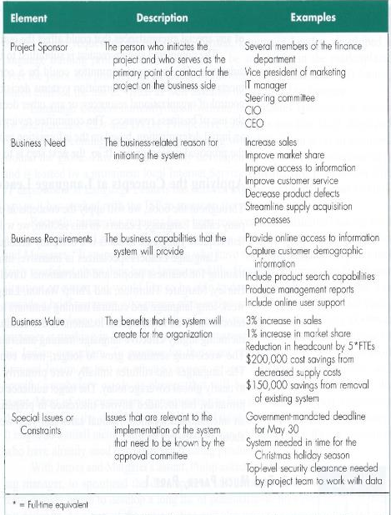
System Request
A system request is a document that summarises the business need and explains how the proposed system adds value to the business.
System Request Form

Slide 6
Input
Process
Output
Analysis
Systems Development Process
Planning
Implementation.
Analysis
Design
Systems Analysis and Design is about getting people, processes and technology together to sort out the bit in the middle!

Slide 7

Analysis
The output of the Planning phase (known as deliverables) are the key inputs into the analysis phase.
The system analyst works extensively with the users of the new system to understand their needs from the new system.
The basic process of analysis involves three steps:
Understand the existing situation.
Identify how existing system can be improved.
Define requirements for the new system.

Slide 8
Analysis: The analysis phase answers the questions of Who will use the system, What the system will do, Where will be used, When it will be used.

Slide 9

Requirements Determination: What tasks the user needs to accomplish with the system to fulfil a job or task.
Use Case Analysis: Use cases are tools to clarify the steps involved in performing user tasks. By understanding what the user needs to do in terms of tasks to perform, the analyst can then determine ways in which the new system can support users’ needs.
Use Case Model
Process Modelling explains the relationship of functions/processes to the user.
Data Flow Diagrams
Data Modelling: the data component of the system is defined in the data model.
Entity Relationship Diagrams

Slide 10
(cont’d)
The final deliverable of the analysis phase is the system proposal.
The system proposal is presented to the approval committee in the form of a system walk-through to explain the system in detail.
The deliverables outputted from the analysis phase are the input for the the design of the new system.

Slide 11
Requirements determination
Requirements determination is performed to transform high-level business requirements into a more detailed, precise list of what the new system must do to provide the needed value to the business

Slide 12
What is a Requirement?
A requirement is a statement of what the system must do or what characteristics it needs to have.
A requirement can describe:
- what the business needs (business requirements)
what the users need to do (user requirements)
what the software should do (functional requirements)
characteristics the system should have (non-functional requirements), and
how the system should be built (system requirements)

Slide 13
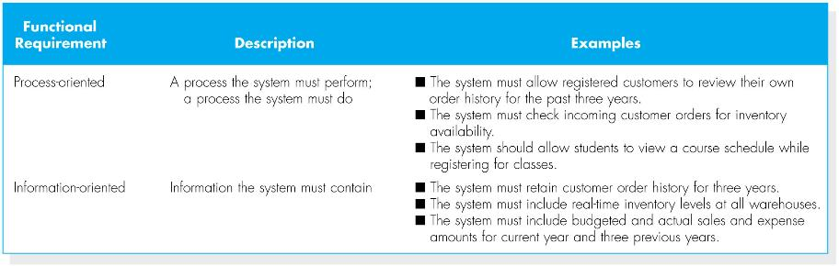
(cont’d)
Functional requirements: relates directly to process the system has to perform as part of supporting a user task and/or information it needs to provide as the user is performing the task.
“what system must do for the user”

Slide 14
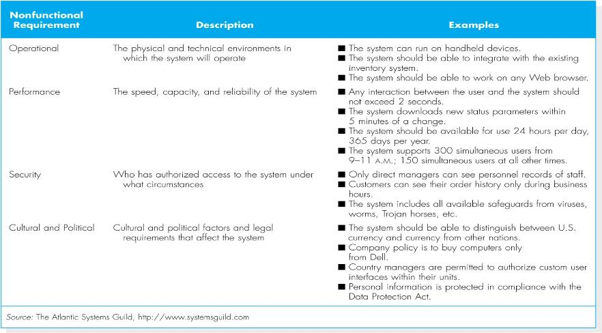
Nonfunctional requirements: Performance and Usability of the system

Slide 15
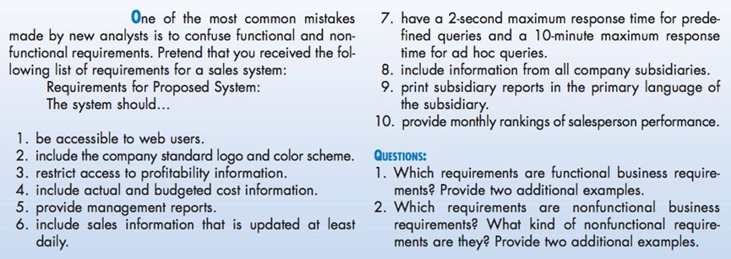
Class exercise

Slide 16
Answer to the class exercise:
Functional requirements:
2, 4, 6, 8.
Nonfunctional requirements:
1, 3, 5, 7, 9, 10.

Slide 17
The Process of Determining Requirements
Both business and IT perspectives are needed to determine requirements during the analysis phase.
The most effective approach is to have both business people and analysts working together
The analyst must also consider how best to extract the requirements from the stakeholders.
The process of determining requirements continues throughout the analysis phase, and the requirements definition evolves over time.

Slide 18
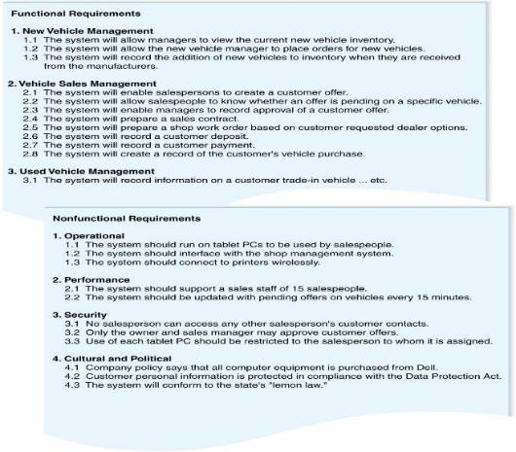
The Requirements Definition Statement

Slide 19
Requirements Definition Statement
The purpose of the requirements definition is to provide a clear statement of what the new system should do in order to achieve the system vision described in the system request.
Also to define the scope of the system. What the final system needs to do?
It serves to establish the users’ expectations for the system.
If misunderstandings arise, the document serves as a resource for clarification.

Slide 20
System Analyst role …
To identify the primary sources of requirements, including the project sponsor and all users of the system.
System analyst must consider how best to elicit the requirements from the stakeholders.
There are a variety of requirement elicitation techniques that can be used to acquire information:
Interviews
Questionnaires
Observation
JAD
Document Analysis

Slide 21

An analyst is like a detective. The best analyst will thoroughly search for requirements using a variety of techniques and make sure that the current business processes and the needs for the new system are well understood before moving into design.

Slide 22
Interviews
The most commonly used requirements elicitation technique
Basic steps:
Selecting Interviewees
Designing Interview Questions
Preparing for the Interview
Conducting the Interview
Post-Interview Follow-up

Slide 23

Types of question
Closed-Ended questions
Enable analysts to control the interview and obtain the information they need.
Open-Ended questions
Designed to gather rich information and give the interviewee more control over the information that is revealed during the interview.
Probing questions
Follow up on what has just been discussed in order for the interviewer to learn more and they often are used when the interviewer in unclear about an interviewees’ answer.

Slide 24
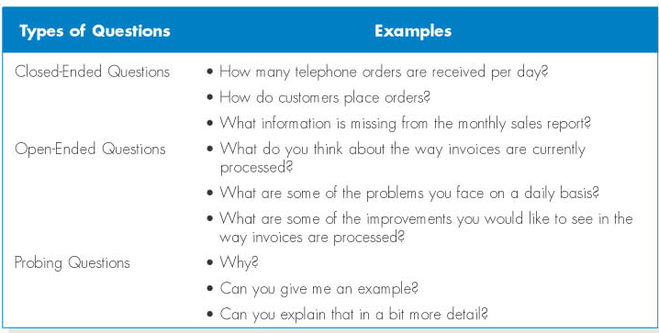
Designing interview questions

Slide 25
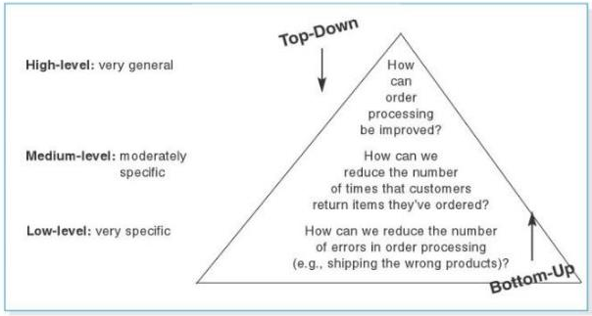
Organising interview questions
Top-down: starts with broad, general issues and works towards more specific ones.
Bottom-up interview: starts with very specific questions and moves to broad issues.

Slide 26

Joint Application Development (JAD)
JAD (developed by IBM in late 1970s) is an information gathering technique that allows the project team, users, and management to work together to identify requirements for the system.
JAD is a structure process in which 10 to 20 users meet under the direction of a facilitator skilled in JAD techniques.
The facilitator is an expert in group process and system analysis and design techniques, sets the meeting agenda and guides the discussion.

Slide 27
JAD
Selecting JAD participants in the same basic way as selecting interview participants.
JAD sessions are designed to collect specific information from users and this requires the development of a set of questions prior to the meeting with a careful plan.
The difference between JAD and interviewing is that all JAD sessions are structured and mostly is based on open-ended questions.
JAD sessions can run from a half day to several weeks depending upon the size and scope of the project.

Slide 28
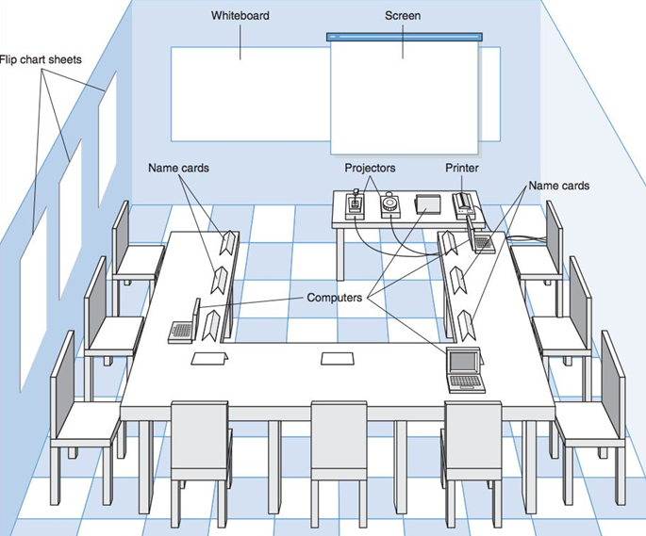
JAD
meeting room

Slide 29
Suppose you were asked to lead a JAD session. List ten guidelines you would follow in playing the proper role of a JAD session leader.

Slide 30
Answer
conduct the JAD sessions off-site,
invite the proper people to the JAD sessions,
establish clear ground rules for the sessions,
set and follow a clear agenda,
distribute the agenda to all participants before the sessions,
remain neutral on issues,
make sure that everyone has the opportunity to participate,
encourage people to be creative and break free of traditional ways of doing things,
manage time effectively,
and follow- up with meeting notes. [2]

Slide 31
Questionnaires
A questionnaire is a set of written questions for obtaining information from individuals.
Selecting participants - using a sample of people who are representative of the entire group.
Designing the questionnaire – following good practice guidelines.
Administering the questionnaire – improving the response rates.
Questionnaire follow-up – developing a report.

Slide 32
Give an example of a closed-ended question, an open-ended question, and a probing question. When would each type question be used?

Slide 33
Answer
Closed-ended questions are used when the interviewer is looking for specific, precise information.
Open-ended questions are used to gather a broader, rich information set. Open-ended questions can help the interviewer learn why things are the way they are, and also give the interviewee the chance to add ideas or issues that the interviewer did not anticipate.
Probing questions are used whenever the interviewer is not satisfied with his/her understanding of the interviewee’s answer, and needs more explanation before moving on to another topic.

Slide 34
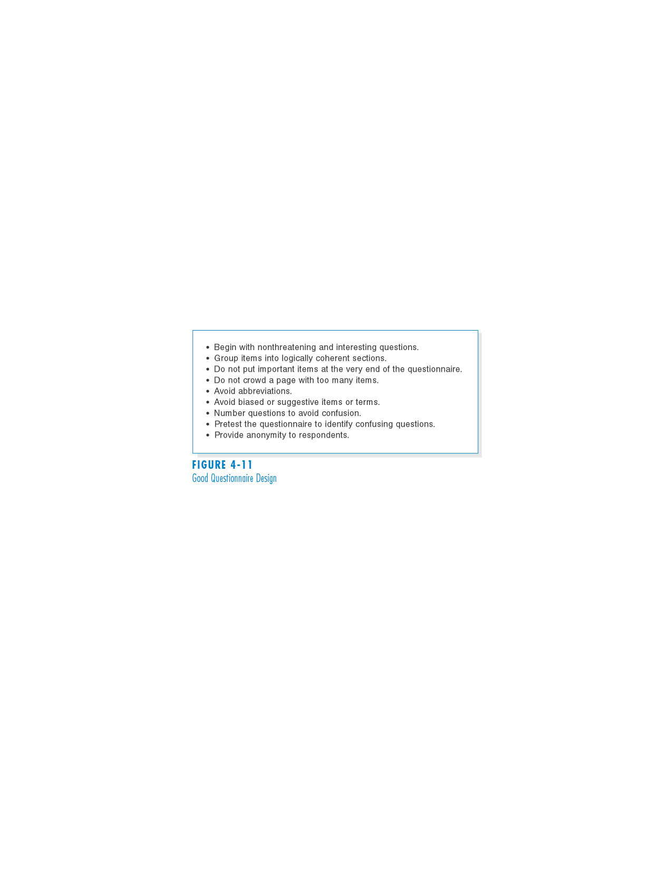
(cont’d)
Good questionnaire design

Slide 35
Document Analysis
Document analysis is used to understand the as-is system.
Forms, reports, policy manuals, organisation charts describe the formal system that the organisation uses.
The “real” or informal system differs from the formal one, and reveals what needs to be changed.
The indication that system needs to be changed is when users create new forms or make changes to the existing forms/reports.

Slide 36
What are the general guidelines for collecting data through analysing documents?

Slide 37
Answer
Document analysis is an effective way to learn about the current system and future system’s requirements. It is important for the analyst to collect and review as many documents as he/she can. He/she should collect organisational mission statements, business plans, organisation charts, business policy manuals, job descriptions, internal and external correspondence, and reports from prior organizational studies. Specifically, he/she should review business forms, reports, written work procedures, and existing system documentation.
[2]

Slide 38
SUMMARY
Analysis focuses on capturing the business requirements for the system
Requirement Determination is the part of analysis in which the project team turns the business requirements stated in the system request into a precise list of requirements.
Five Requirements Elicitation Techniques can be used to elicit business requirements.

Slide 39
References
Dennis, A., and Wixom, B. H, “Systems Analysis and Design”, 5th Edition, John Wiley & Sons (2013), Chapter three.
Hoffer, V.G. “Essentials of Systems Analysis & Design”, 5th Edition, Pearson (2014)

